Slide 1
Weapon Detection System using Python and Deep Learning
Presented by Hemant Tiwari 1729010066
Supervised by Jatin Swami 1729010072
Ms. Aishwarya Gupta Jalaj Chitkara 1729010069

Slide 2
Introduction
Gun violence in metropolitan areas of the India remains stubbornly high, despite decades of gun control efforts. Many gun-related crimes, including armed assault and robbery, occur in public places with existing surveillance systems. However, most systems rely on constant human supervision; this often demands an unrealistic amount of vigilance, and can be expensive and ineffective when multiple video streams are present.
The increase of video surveillance in public spaces and the proliferation of body cameras for police can potentially be leveraged for gun detection systems. Video systems could alert police and surveillance personnel when a gun is detected in real time, resulting in prompter action.
For this system to work, we fine-tuned our own dataset of about 3,000 weapon-based images, pulled from the Internet Movie Firearm Database, [citation] home-made videos, and frames from select surveillance- or news-based YouTube videos. This was so that each image would contain weapons in a variety of different contexts, situations, orientations, and distances. We trained these on a Tensorflow-based version of the Overfeat Convolutional Neural Network architecture

Slide 3
Technical Details:
In this presentation, we’ll discuss our two-phase weapon detection system, detailing how our computer vision/deep learning pipeline will be implemented.
From there, we’ll review the dataset we’ll be using to train our custom weapon detector.
We’ll then implement a Python script to train a weapon detection system on our dataset using Keras and TensorFlow.
We’ll use this Python script to train a weapon detection system and review the results.
Given the trained gun detection system , we’ll proceed to implement two more additional Python scripts used to:
Detect weapons in images
Detect weapons in real-time video streams

Slide 4
Methods
Data Collection and Preprocessing: We first downloaded 10,000 images for the dataset in which 3641 images of the knife from IMFDB, a movie internet firearms database. Approximately 2,497 images of Long Gun, and another 3,876 images of Small gun .
We sorted 7000 images for train set and 3000 for test set and made them work with our python script using TensorBox framework i.e. a Google Machine Learning Library for python.
Connecting the camera with our system in the final process to make things work.

Slide 5
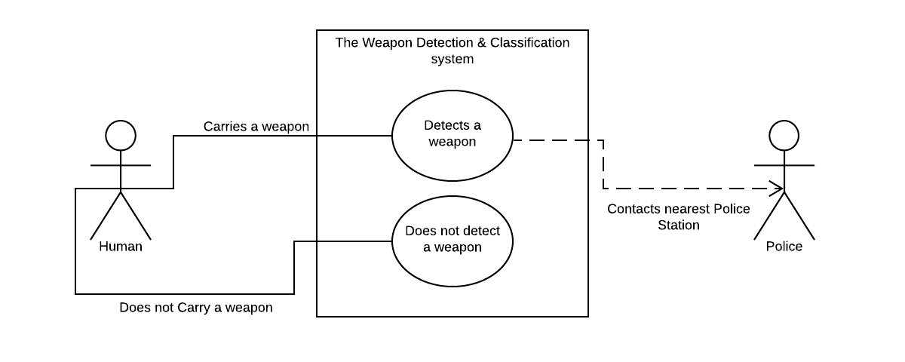
Weapon Detection System Visual Representation

Slide 6
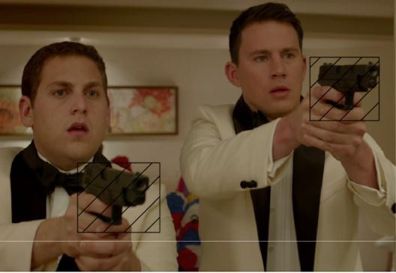
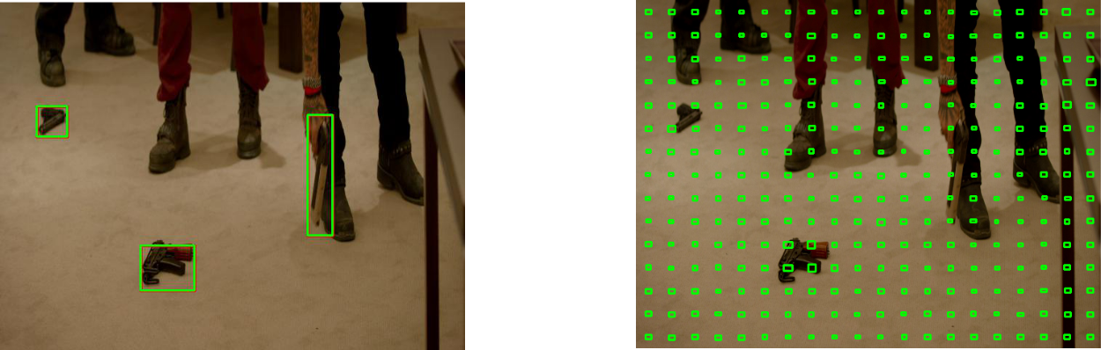
Weapon Detection System Image Samples

